Slide 1
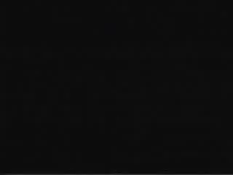
Schoolhouse Rock
Notes:
https://www.youtube.com/watch?v=Qk4N5kkifGQ&list=PL2Th9LBsWQq7SWCgd4aMjSIIJkYwgGIZ-

Slide 2
Reminders
Quiz 5 is due Tonight by 11:59pm (no late days)
HW6 is due on Wedneday

Slide 3
RNNs Wrap Up
Jurafsky and Martin Chapters 7 and 9

Slide 4
Recurrent Neural Language Models
Unlike n-gram LMs and feedforward networks with sliding windows, RNN LMs don’t use a fixed size context window.
They predict the next word in a sequence by using the current word and the previous hidden state as input.
The hidden state embodies information about all of the preceding words all the way back to the beginning of the sequence.
Thus they can potentially take more context into account than n-gram LMs and NN LMs that use a sliding window.

Slide 5
RNNs
time
Notes:
A simple recurrent neural network shown unrolled in time. Network layers are copied for each time step, while the weights U , V and W are shared in common across all time steps.
The fact that the computation at time t requires the value of the hidden layer from time t − 1 mandates an incremental inference algorithm that proceeds from the start of the sequence to the end. The sequential nature of simple recurrent networks can also be seen by unrolling the network in time as is shown here.

Slide 6
Generation with an RNN LM

Slide 7
Tag Sequences
Notes:
Part of speech tagging with a simple RNN

Slide 8
Sequence Classifiers
Notes:
Sequence classification using a simple RNN combined with a feedforward net- work. The final hidden state from the RNN is used as the input to a feedforward network that performs the classification.
Note that in this approach there are no intermediate outputs for the words in the sequence preceding the last element. Therefore, there are no loss terms associ- ated with those elements. Instead, the loss function used to train the weights in the network is based entirely on the final text classification task. Specifically, the out- put from the softmax output from the feedforward classifier together with a cross- entropy loss drives the training. The error signal from the classification is backprop- agated all the way through the weights in the feedforward classifier through, to its input, and then through to the three sets of weights in the RNN. This combination of a simple recurrent network with a feedforward classifier is our first example of a deep neural network. And the training regimen that uses the loss from a downstream application to adjust the weights all the way through the network is referred to as end-to-end training.

Slide 9
Bidirectional RNNs

Slide 10
Bidirectional RNNs for sequence classification

Slide 11
Current state of the art neural LMs
ELMo
GPT
BERT
GPT-2
https://talktotransformer.com
https://play.aidungeon.io
Notes:
ELMo: Embeddings from Language Models
GPT: Improving Language Understanding by Generative PreTraining
BERT: Bidirectional Encoder Representations from Transformers.

Slide 12
Summary
RNNs allow us to process sequences one element at a time.
RNNs can have one output per input. The output at a point in time is based on the current input and the hidden layer from the previous step.
RNNs can be trained similarly to feed forward NNs are using backpropagation through time.
Applications: LMs, generation, sequence labeling like POS tagging, sequence classification.
Next time: POS tagging!

Slide 13
Part of Speech Tagging
Jurafsky and Martin Chapter 8

Slide 14
Ancient Greek tag set
(c. 100 BC)
Noun
Verb
Pronoun
Preposition
Adverb
Conjunction
Participle
Article

Slide 15
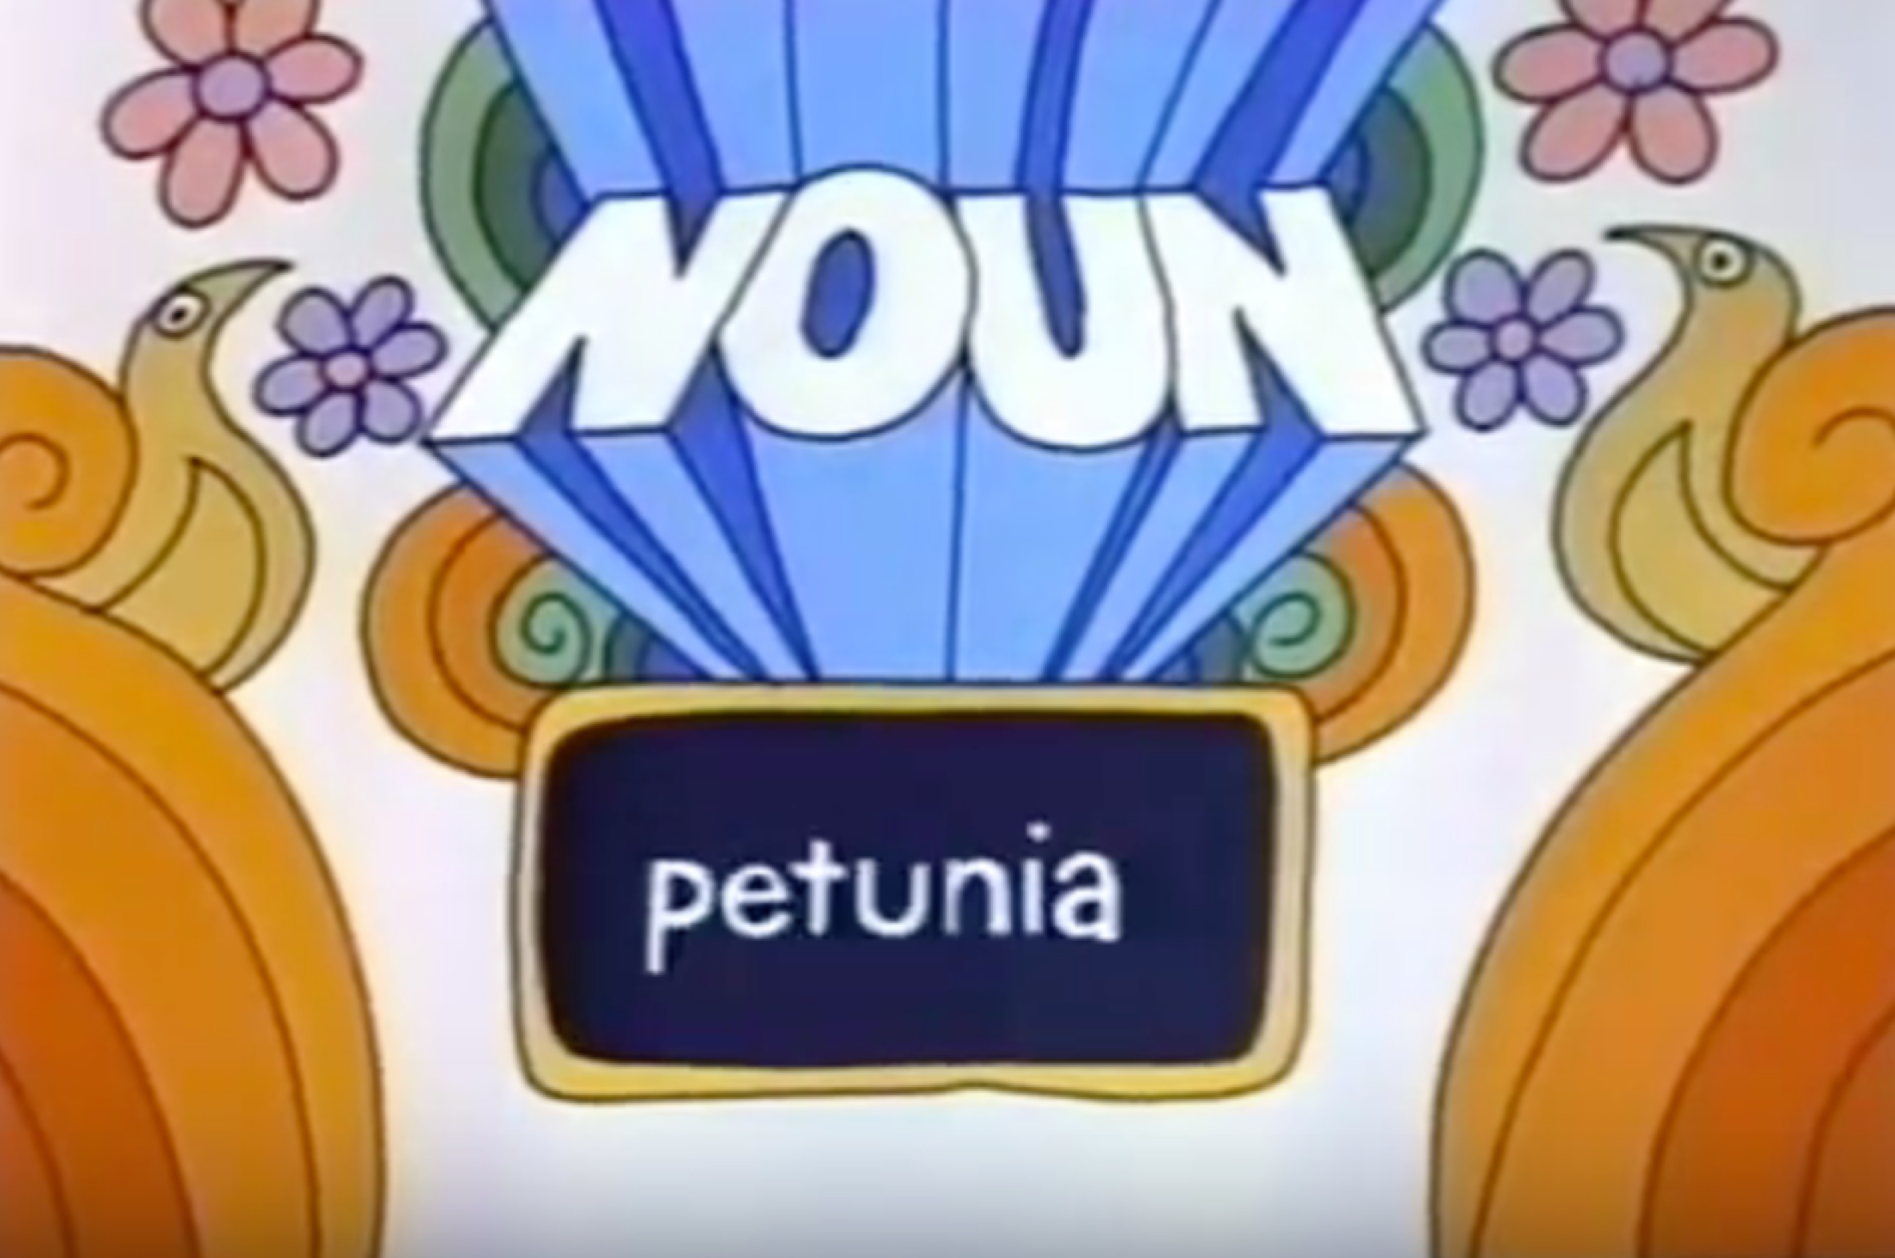
Schoolhouse Rock tag set
(c. 1970)
Noun
Verb
Pronoun
Preposition
Adverb
Conjunction
Participle
Article
Adjective
Interjection

Slide 16
Word classes
Every word in the vocabulary belongs to one or more of these word classes.
Assigning the classes to words in a sentence is called part of speech (POS) tagging.
Many words can have multiple POS tags. Can you think of some?

Slide 17
Open classes
Four major classes:
Noun
Verbs
Adjectives
Adverbs
English has all four but not every language does.

Slide 18
Nouns
Person, place or thing.
Proper nouns: names of specific entities or people.
Common nouns
Count nouns - allow grammatical enumeration, occurring in both singular and plural.
Mass nouns - conceptualized as homogenous groups. Cannot be pluralized. Can appear without determiners even in singular form.
Notes:
Proper nouns: Professor Marcus, University of Pennsylvania, NRA
Count nouns: cats, democracy, cereal. One cat, two cats. (grammatical)
Mass nouns: snow, salt, communism. *One snow, *two snows. (ungrammatical)
Mass nouns can also appear without articles where singular count nouns cannot: Snow is white but not *Goat is white
The cat is cute. (grammatical)
*Cat is cute
Cats are cute
The snow is white.
Snow is white (grammatical)
Count nouns allow grammatical enumeration, occurring in both the singular and plural (goat/goats, relationship/relationships) and they can be counted (one goat, two goats). Mass nouns are used when something is conceptualized as a homogeneous group. So words like snow, salt, and communism are not counted (i.e., *two snows or *two communisms). Mass nouns can also appear without articles where singular count nouns cannot (Snow is white but not *Goat is white).

Slide 19
Verbs
Words describing actions and processes.
English verbs have inflectional markers.
3rd person singular
Non-3rd person singular
Progressive (ing)
Past
Notes:
compute
suffix
3rd person singular
He/she/it computes
+s
Non-3rd person singular
They/you/I compute

Slide 20
Verbs
Words describing actions and processes.
English verbs have inflectional markers.
 | Root: compute | suffix
3rd person singular | He/she/it computes | +s
Non-3rd person singular | They/you/I compute | __
Progressive (ing) | Computing | +ing
Past | Computed | +ed
Notes:
Compute
3rd person singular it computes +s
Non-3rd person singular
Progressive (ing)
Past

Slide 21

Adjectives
Word that describe properties or qualities.
Notes:
Qualtities: color, age, value (good/bad), material, subjective words (amazing)
Scalar adjectives.
Temperature: lukewarm < warm < hot < boiling < scalding < face-melting.
Most languages have adjectives for the concepts of color (white, black), age (old, young), and value (good, bad), but there are languages without adjectives. In Korean, for example, the words corresponding to English adjectives act as a subclass of verbs, so what is in English an adjective “beautiful” acts in Korean like a verb meaning “to be beautiful”.
The interpretation of adjective-noun pairs plays a crucial role in tasks such as rec- ognizing textual entailment. Formal se- mantics often places adjectives into a taxonomy which should dictate adjec- tives’ entailment behavior when placed in adjective-noun compounds. However, we show experimentally that the behavior of subsective adjectives (e.g. red) versus non-subsective adjectives (e.g. fake) is not as cut and dry as often assumed. For ex- ample, inferences are not always symmet- ric: while ID is generally considered to be mutually exclusive with fake ID, fake ID is considered to entail ID. We discuss the im- plications of these findings for automated natural language understanding.
Privative Non-Subsective (AN \ N = ;)
anti- erstwhile false hypothetical imaginary mock onetime past phony simulated spurious virtual
deputy fake former mythical pseudo- would-be
artificial ex- fictional
counterfeit fabricated fictitious
Plain Non-Subsective (AN 6⇢ N and AN \ N 6= ;)
alleged believed dubious future likely possible probable seeming theoretical
apparent debatable erroneous historic mistaken potential proposed so-called uncertain
arguable disputed expected impossible ostensible predicted putative supposed unlikely
assumed doubtful faulty improbable plausible presumed questionable suspicious unsuccessful

Slide 22
Adverb
Modify verbs or whole verb phrases or other words like adjectives
 | Examples
Locatives | here, home, uphill
Degree | Very, extremely, extraordinarily, somewhat, not really, --ish
Manner | slowly, quickly, softly, gently, alluringly
Temporal | yesterday, Monday, last semester
Notes:
Actually, I ran home extremely quickly yesterday.
Directional adverbs or locative adverbs (home, here, downhill) specify the direction or location of some action; degree adverbs (extremely, very, somewhat) specify the extent of some action, process, or property; manner adverbs (slowly, slinkily, delicately) describe the manner of some action or process; and temporal adverbs describe the time that some action or event took place (yesterday, Monday).

Slide 23
Closed Classes
numerals | one, two, nth, first, second, …
prepositions | of, on, over, under, to, from, around
determiners | indefinite: some, a, an definite: the, this, that, the
pronouns | she, he, it, they, them, who, whoever, whatever
conjunctions | and, or, but
particles (preposition joined to a verb) | knocked over
auxiliary verbs | was
Notes:
Auxiliary verbs:
Tense: when
Aspect: still going on?
Polarity negation
Mood, desirable./ possible suggeted

Slide 24
Tag | Description | Example | Tag | Description | Example
CC | coordinating conjunction | and, but, or | SYM | symbol | +, %, &
CD | cardinal number | one, two | TO | “to” | to
DT | determiner | a, the | UH | interjection | ah, oops
EX | existential “there” | there | VB | verb base form | eat
FW | foreign word | mea culpa | VBD | verb past tense | ate
IN | proposition/sub-conj | of, in, by | VBG | verb gerund | eating
JJ | adjective | yellow | VBN | verb past participle | eaten
JJR | comparative adjective | bigger | VBP | verb non-3sg pres | eat
JJS | superlative adjective | wildest | VBZ | verb 3sg pres | eats
LS | list item marker | 1, 2, One | WDT | wh-determiner | which, that
MD | modal | can, should | WP | wh-pronoun | what, who
NN | noun, singular or mass | llama | WP$ | possessive wh- | whose
NNS | noun, plural | llamas | WRB | wh-adverb | how, where
NNP | proper noun, sing. | IBM | $ | dollar sign | $
NNPS | proper noun, plural | Carolinas | # | pound sign | #
PDT | predeterminer | all, both | “ | left quote | ‘ or “
POS | possessive ending | ‘s | ” | right quote | ’ or ”
PRP | personal pronoun | I, you, we | ( | left parenthesis | [, (, {, <
PRP$ | possessive pronoun | your, one’s | ) | right parenthesis | ], ), }, >

Slide 25
POS Tagging
Words are ambiguous, so tagging must resolve disambiguate.
The amount of tag ambiguity for word types in the Brown and WSJ corpora from the Treebank-3 (45-tag) tagging. These statistics include punctuation as words, and assume words are kept in their original case.
Types: | WSJ | Brown
Unambiguous (1 tag) | 44,432 (86%) | 45,799 (85%)
Ambiguous (2+ tags) | 7,025 (14%) | 8,050 (15%)
Tokens:
Unambiguous (1 tag) | 577,421 (45%) | 384,349 (33%)
Ambiguous (2+ tags) | 711,780 (55%) | 786,646 (67%)
Notes:
CCB – redo this as a graph?

Slide 26
Some words have up to 6 tags
 | Sentence | Tag
1 | Earnings took a back seat
2 | A small yard in the back
3 | Senators back the bill
4 | He started to back towards the door
5 | To buy back stock.
6 | I was young back then.
Notes:
Adj
Noun
Past tense verb
Infinitival verb
Verb+Particle
Adverb (temporal)

Slide 27
Corpora with manual POS tags
Brown corpus – 1 million words of 500 written English texts from different genres.
WSJ corpus – 1 million words from the Wall Street Journal
Switchboard corpus – 2 million words of telephone conversations
The/DT grand/JJ jury/NN commented/VBD on/IN a/DT number/NN of/IN other/JJ topics/NNS ./.
There/EX are/VBP 70/CD children/NNS there/RB

Slide 28
Most frequent class baseline
Many words are easy to disambiguate, because their different tags aren’t equally likely.
Simplistic baseline for POS tagging: given an ambiguous word, choose the tag which is most frequent in the training corpus.
Most Frequent Class Baseline: Always compare a classifier against a baseline at least as good as the most frequent class baseline (assigning each token to the class it occurred in most often in the training set).
Notes:
For example a can be the determiner, or the letter, but the determiner is much more likely.

Slide 29
How good is the baseline?
This lets us know how hard the task is (and how much room for improvement real models have).
Accuracy for POS taggers is measured as the percent of tags that are correctly labeled when compared to human labels on a test set.
Most Frequent Class Baseline: 92%
State of the art in POS tagging: 97%
(Much harder for other languages and other genres)
Notes:
If we train on the WSJ training corpus and test on sec- tions 22-24 of the same corpus the most-frequent-tag baseline achieves an accuracy of 92.34%.

Slide 30
Hidden Markov Models (HMMs)
The HMM is a probabilistic sequence model.
A sequence model assigns a label to each unit in a sequence, mapping a sequence of observations to a sequence of labels.
Given a sequence of words, an HMM computes a probability distribution over a sequence of POS tags.
Notes:
A Markov model embodies the Markov assumption on the probabilities of this sequence: that when predicting the future, the past doesn’t matter, only the present.
Hidden = not observed directly.. For example we don’t normally observe part-of-speech tags in a text. Rather, we see words, and must infer the tags from the word sequence.

Slide 31
Sequence Models
A sequence model or sequence classifier is a model whose job is to assign a label or class to each unit in a sequence, thus mapping a sequence of observations to a sequence of labels.
A Hidden Markov Model (HMM) is a probabilistic sequence model: given a sequence of words, it computes a probability distribution over possible sequences of labels and chooses the best label sequence.

Slide 32
What is hidden?
We used a Markov model in n-gram LMs. This kind of model is sometimes called a Markov chain. It is useful when we need to compute a probability for a sequence of observable events.
In many cases the events we are interested in are not observed directly. We don’t see part-of-speech tags in a text. We just see words, and need to infer the tags from the word sequence.
We call the tags hidden because they are not observed.

Slide 33
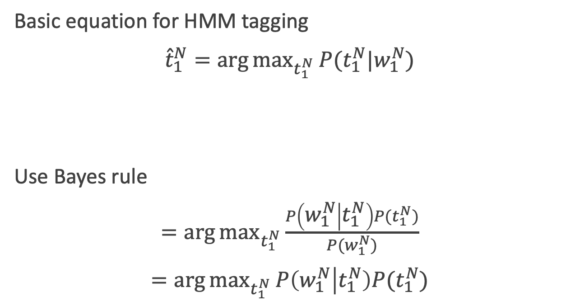
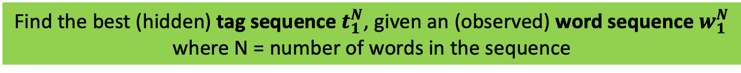
HMMs for tagging
Basic equation for HMM tagging
${\hat{t}}_{1}^{N}=\arg{\max_{t_{1}^{N}}{P(t_{1}^{N}|w_{1}^{N})}}$
Use Bayes rule
$=\arg{\max_{t_{1}^{N}}{\frac{P\left(w_{1}^{N} | t_{1}^{N}\right)P(t_{1}^{N})}{P(w_{1}^{N})}}}$
$=\arg{\max_{t_{1}^{N}}{P\left(w_{1}^{N} | t_{1}^{N}\right)P(t_{1}^{N})}}$
Find the best (hidden) tag sequence $t_{1}^{N}$, given an (observed) word sequence $w_{1}^{N}$
where N = number of words in the sequence
Notes:
Hidden Markov Models are trained on tagged corpora.
Fully supervised with MLE estimation

Slide 34
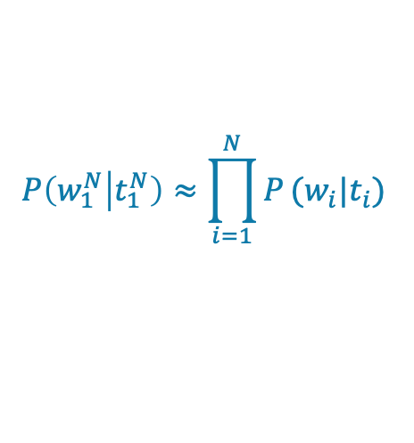
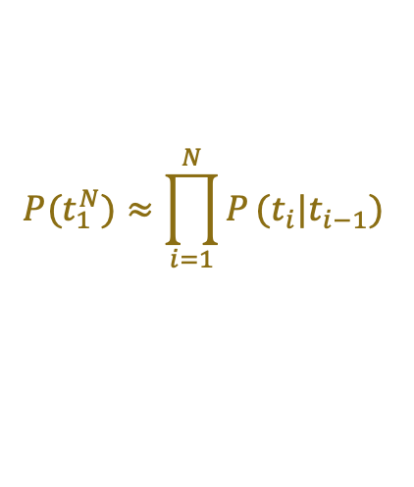
Simplifying Assumptions
Output Independence: Probability of a word only depends on its own tag, and it is independent of neighboring word and tags
Markov assumption: The probability of a tag depends only on previous tag, not the whole tag sequence.
$$P\left(w_{1}^{N} | t_{1}^{N}\right)≈\prod_{i=1}^{N}{P}(w_{i}|t_{i})$$
$$P(t_{1}^{N})≈\prod_{i=1}^{N}{P}(t_{i}|t_{i−1})$$

Slide 35
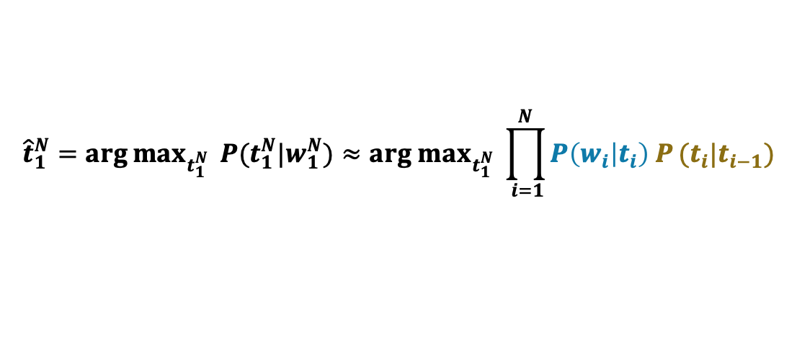
Simplifying Assumptions
Output Independence: Probability of a word only depends on its own tag, and it is independent of neighboring word and tags
Markov assumption: The probability of a tag depends only on previous tag, not the whole tag sequence.
$$P\left(w_{1}^{N} | t_{1}^{N}\right)≈\prod_{i=1}^{N}{P}(w_{i}|t_{i})$$
Emission probability
$$P(t_{1}^{N})≈\prod_{i=1}^{N}{P}(t_{i}|t_{i−1})$$
Transition probability
$${\hat{t}}_{1}^{N}=\arg{\max_{t_{1}^{N}}{ P(t_{1}^{N}|w_{1}^{N})}}≈{arg max}_{t_{1}^{N}} \prod_{ i=1}^{N}{P\left(w_{i} | t_{i}\right) P}(t_{i}|t_{i−1})$$
Combining:

Slide 36
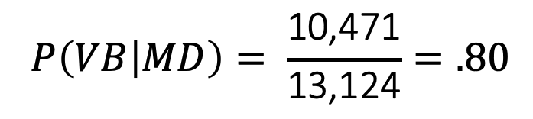
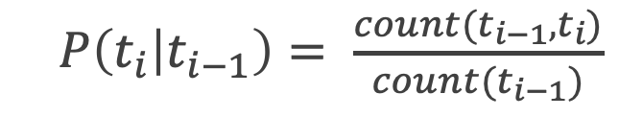
HMM Tagger Components
$P\left(t_{i} | t_{i−1}\right)= \frac{count(t_{i−1}, t_{i})}{count(t_{i−1})}$
Transition probability
In the WSJ corpus, a modal verb (MD) occurs 13,124 times. 10,471 times the MD is followed by a verb (VB). Therefore,
Transition probabilities are sometimes called the A probabilities.
$$P\left(VB | MD\right)= \frac{\text{10,471}}{\text{13,124}}=.80$$

Slide 37
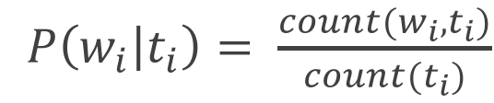
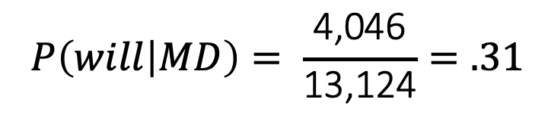
HMM Tagger Components
$P\left(w_{i} | t_{i}\right)= \frac{count(w_{i}, t_{i})}{count(t_{i})}$
Emission probability
Of the 13,124 occurrences of modal verbs (MD) in the WSJ corpus, the word will represents 4,046 of the words tagged as MD.
Emission probabilities are sometimes called the B probabilities.
$$P\left(will | MD\right)= \frac{\text{4}\text{,}\text{046}}{\text{13,124}}=.31$$
Notes:
Is this the same as asking “which is the most likely tag for the word will?” No. That would be the posterior P(MD|will). Instead, P(will|MD) answers the slightly counterintuitive question “If we were going to generate a MD, how likely is it that this modal would be will?”
We saw this kind of Bayesian modeling in Chapter 4 on Naive Bayes classification; recall that this likelihood term is not asking

Slide 38
Emission probability
Transition probability
Notes:
An illustration of the two parts of an HMM representation: the A transition probabilities used to compute the prior probability, and the B observation likelihoods that are associated with each state, one likelihood for each possible observation word.

Slide 39
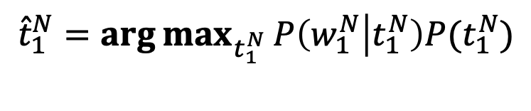
HMM decoding
For a model with hidden variables, the task of determining the hidden variables sequence corresponding to the sequence of observations is called “decoding”.
Decoding: Given an HMM λ = (A, B) and a sequence of observations O = w₁, w₂ , ..., w_{T} , find the most probable sequence of states Q = t₁t₂t₃ ...t_{T} .
$${\hat{t}}_{1}^{N}=\arg{\max_{t_{1}^{N}}{P\left(w_{1}^{N} | t_{1}^{N}\right)P(t_{1}^{N})}}$$

Slide 40
HMM decoding
Input:
Let us learn about HMMs
Output Best
Labels:
VB PRP VB IN NNP
Compute probability for all possible sequence of labels:
Let us learn about HMMs
VB PRP VB IN NNP
p=0.45
IN VB VB NN DT
p=0.03
…
PRP . NN IN WP
p=0.00006

Slide 41
How many label sequences?
T observations
Input:
Let us learn about HMMs
CC
CD
DT
EX
FW
IN
JJ
JJR
JJS
LS
MD
NN
NNS
NNP
NNPS
PDT
POS
PRP
PRP$
RB
RBR
RBS
RP
SYM
TO
UH
VB
VBD
VBG
VBN
VBP
VBZ
WDT
WP
WP$
WRB
CC
CD
DT
EX
FW
IN
JJ
JJR
JJS
LS
MD
NN
NNS
NNP
NNPS
PDT
POS
PRP
PRP$
RB
RBR
RBS
RP
SYM
TO
UH
VB
VBD
VBG
VBN
VBP
VBZ
WDT
WP
WP$
WRB
CC
CD
DT
EX
FW
IN
JJ
JJR
JJS
LS
MD
NN
NNS
NNP
NNPS
PDT
POS
PRP
PRP$
RB
RBR
RBS
RP
SYM
TO
UH
VB
VBD
VBG
VBN
VBP
VBZ
WDT
WP
WP$
WRB
CC
CD
DT
EX
FW
IN
JJ
JJR
JJS
LS
MD
NN
NNS
NNP
NNPS
PDT
POS
PRP
PRP$
RB
RBR
RBS
RP
SYM
TO
UH
VB
VBD
VBG
VBN
VBP
VBZ
WDT
WP
WP$
WRB
CC
CD
DT
EX
FW
IN
JJ
JJR
JJS
LS
MD
NN
NNS
NNP
NNPS
PDT
POS
PRP
PRP$
RB
RBR
RBS
RP
SYM
TO
UH
VB
VBD
VBG
VBN
VBP
VBZ
WDT
WP
WP$
WRB
N states

Slide 42
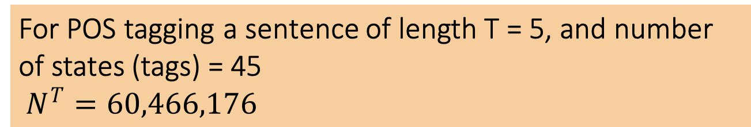
How many label sequences?
T observations
Input:
Let us learn about HMMs
CC
CD
DT
EX
FW
IN
JJ
JJR
JJS
LS
MD
NN
NNS
NNP
NNPS
PDT
POS
PRP
PRP$
RB
RBR
RBS
RP
SYM
TO
UH
VB
VBD
VBG
VBN
VBP
VBZ
WDT
WP
WP$
WRB
CC
CD
DT
EX
FW
IN
JJ
JJR
JJS
LS
MD
NN
NNS
NNP
NNPS
PDT
POS
PRP
PRP$
RB
RBR
RBS
RP
SYM
TO
UH
VB
VBD
VBG
VBN
VBP
VBZ
WDT
WP
WP$
WRB
CC
CD
DT
EX
FW
IN
JJ
JJR
JJS
LS
MD
NN
NNS
NNP
NNPS
PDT
POS
PRP
PRP$
RB
RBR
RBS
RP
SYM
TO
UH
VB
VBD
VBG
VBN
VBP
VBZ
WDT
WP
WP$
WRB
CC
CD
DT
EX
FW
IN
JJ
JJR
JJS
LS
MD
NN
NNS
NNP
NNPS
PDT
POS
PRP
PRP$
RB
RBR
RBS
RP
SYM
TO
UH
VB
VBD
VBG
VBN
VBP
VBZ
WDT
WP
WP$
WRB
CC
CD
DT
EX
FW
IN
JJ
JJR
JJS
LS
MD
NN
NNS
NNP
NNPS
PDT
POS
PRP
PRP$
RB
RBR
RBS
RP
SYM
TO
UH
VB
VBD
VBG
VBN
VBP
VBZ
WDT
WP
WP$
WRB
For POS tagging a sentence of length T = 5, and number of states (tags) = 45
$N^{T}=60,466,176$
N states

Slide 43
Dynamic Programming
Coined by Richard Bellman in 1940s
“My boss, Secretary of Defense, actually had a pathological fear and hatred of the word ‘research’. Dynamic has a very interesting property as an adjective, and that it's impossible to use the word dynamic in a pejorative sense. Try thinking of some combination that will possibly give it a pejorative meaning. It's impossible!”
Method for solving complex problems by breaking them down into simpler sub-problems and storing their solutions
Technique of storing solutions to sub-problems instead of recomputing them is called “memoization”

Slide 44
Dynamic Programming
Fibonacci Series
fib(n) = fib(n − 1) + fib(n − 2)
fib(5)
fib(4) + fib(3)
(fib(3) + fib(2)) + (fib(2) + fib(1))
((fib(2) + fib(1)) + (fib(1) + fib(0))) + ((fib(1) + fib(0)) + fib(1))
(((fib(1) + fib(0)) + fib(1)) + (fib(1) + fib(0))) + ((fib(1) + fib(0)) + fib(1))
Instead of calling fib(3) multiple times, we should store it and lookup instead of recomputing

Slide 45
Viterbi Algorithm
Notes:
The decoding algorithm for HMMs is the Viterbi algorithm shown here. It is an instance of dynamic programming.
The Viterbi algorithm first sets up a probability matrix or lattice, with one column for each observation ot and one row for each state in the state graph. Each column thus has a cell for each state.
Each cell of the lattice, vt ( j), represents the probability that the HMM is in state j after seeing the first t observations and passing through the most probable state sequence q1,...,qt−1, given the HMM λ. The value of each cell vt(j) is computed by recursively taking the most probable path that could lead us to this cell.
π is the initial probability distribution over states. πi is the probability that the Markov chain will start with tag i.
B probabilities are the Emission probabilities.
A probabilities are the transition probabilities.

Slide 46
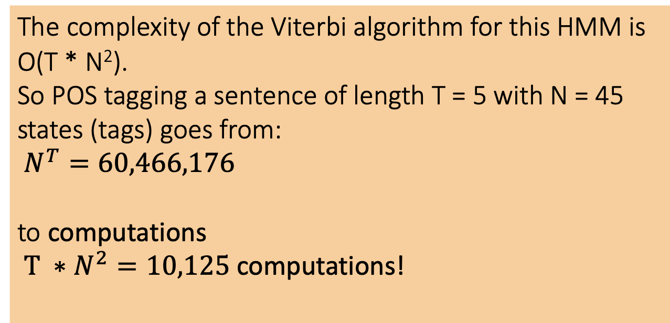
Viterbi Algorithm
The complexity of the Viterbi algorithm for this HMM is O(T * N²).
So POS tagging a sentence of length T = 5 with N = 45 states (tags) goes from:
$N^{T}=60,466,176$
to computations
$T ∗N^{2}=10,125$ computations!
Notes:
In this case, that means 10,000 times faster.

Slide 47
Viterbi Lattice
Notes:
A sketch of the lattice for Janet will back the bill, showing the possible tags (qi) for each word and highlighting the path corresponding to the correct tag sequence through the hidden states. States (parts-of-speech) which have a zero probability of generating a particular word according to the B matrix (such as the probability that a determiner DT will be realized as Janet) are greyed out.

Slide 48
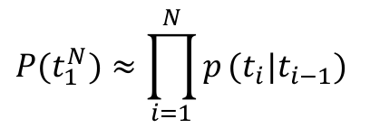
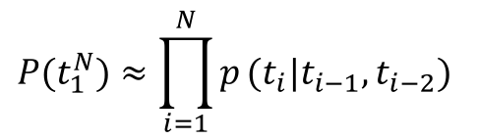
Trigram HMMs
So far, we had a bigram assumption. The probability of a tag depends only on previous tag, not the whole tag sequence.
We could extend it to a trigram model
$$P(t_{1}^{N})≈\prod_{i=1}^{N}{p}(t_{i}|t_{i−1})$$
$$P(t_{1}^{N})≈\prod_{i=1}^{N}{p}(t_{i}|t_{i−1}, t_{i−2})$$
Notes:
Extending the algorithm from bigram to trigram taggers gives a small (perhaps a half point) increase in performance, but conditioning on two previous tags instead of one requires a significant change to the Viterbi algorithm. For each cell, instead of taking a max over transitions from each cell in the previous column, we have to take a max over paths through the cells in the previous two columns, thus considering N2 rather than N hidden states at every observation.

Slide 49
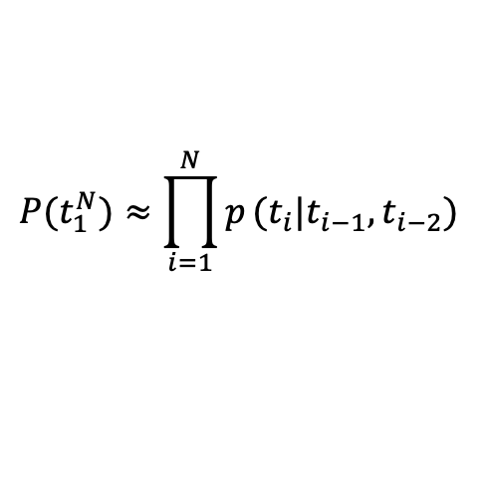
Trigram HMMs
So far, we had a bigram assumption. The probability of a tag depends only on previous tag, not the whole tag sequence.
We could extend it to a trigram model
$$P(t_{1}^{N})≈\prod_{i=1}^{N}{p}(t_{i}|t_{i−1})$$
The complexity of the trigram HMM increases from O(N²T) to O(N³T). The number of states (N) gets larger since we have to compare every pair of 45 tags, instead of just each tag, so we have 45³ = 91,125 computations per column.
$$P(t_{1}^{N})≈\prod_{i=1}^{N}{p}(t_{i}|t_{i−1}, t_{i−2})$$
Notes:
Extending the algorithm from bigram to trigram taggers gives a small (perhaps a half point) increase in performance, but conditioning on two previous tags instead of one requires a significant change to the Viterbi algorithm. For each cell, instead of taking a max over transitions from each cell in the previous column, we have to take a max over paths through the cells in the previous two columns, thus considering N2 rather than N hidden states at every observation.

Slide 50
Beam Search
One common solution to the complexity problem is the use of beam search decoding. Instead of keeping the entire column of states at each time point t, beam search just keeps the best few hypothesis.
At time t this requires computing the Viterbi score for each of the N cells, sorting the scores, and keeping only the best-scoring states. The rest are pruned out and not continued forward to time t+1.

Slide 51
Beam Search
Notes:
A beam search version of the previous lattice, showing a beam width of 2. At each time t, all (non-zero) states are computed, but then they are sorted and only the best 2 states are propagated forward and the rest are pruned, shown in orange.
One way to implement beam search is to keep a fixed number of states instead of all N current states. Here the beam width β is a fixed number of states. Alternatively β can be modeled as a fixed percentage of the N states, or as a probability threshold.

Slide 52
Unknown words
To achieve high accuracy with POS taggers, it is also important to have a good model for dealing with unknown words.
Proper names and acronyms are created very often, and even new common nouns and verbs enter the language at a surprising rate.
Notes:
Call back to open class words.

Slide 53
Unknown words
One useful feature for distinguishing parts of speech is word shape (proper nouns start with a capital).
The strongest feature is morphology.
Words that end in
-s tend to be plural nouns (NNS)
-ed tend to be past participles (VBN)
-able tend to be adjectives (JJ)
and so on

Slide 54
Learning suffix model
Store the final letter sequence (suffixes) for up to 10 letters.
For each such sequence, record the probability of the tag that it was associated with during training.
Use back-off to smooth these probabilities for. Successively shorter sequences.
Trigram HMM with unknown word handling: 96.7%
State-of-the-art neural network POS tagging: 97%

Slide 55
Maximum Entropy Markov Models
Could we add features like word shape and suffixes directly into the model in a clean way? We had this for classification with logistic regression. But it’s not a sequence model, since it assigns a class to a single observation.
We can turn it into a discriminative sequence model by running it on successive words, using the class assigned to the prior word as a feature in the classification of the next word. This is called a Maximum Entropy Markov Model (MEMM).
Notes:
While an HMM can achieve very high accuracy, we saw that it requires a number of architectural innovations to deal with unknown words, backoff, suffixes, and so on. It would be so much easier if we could add arbitrary features directly into the model in a clean way, but that’s hard for generative models like HMMs.

Slide 56
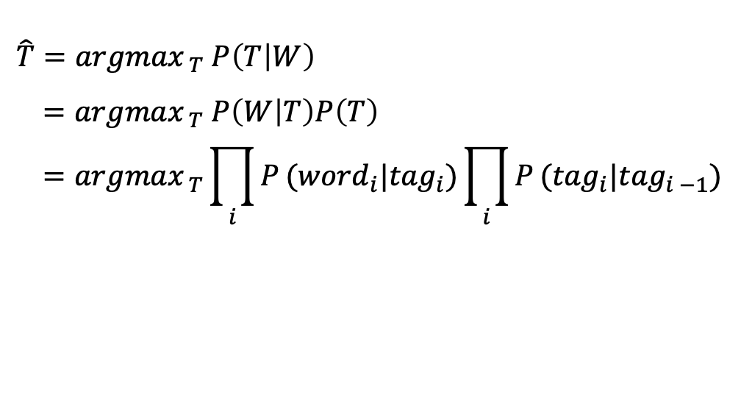
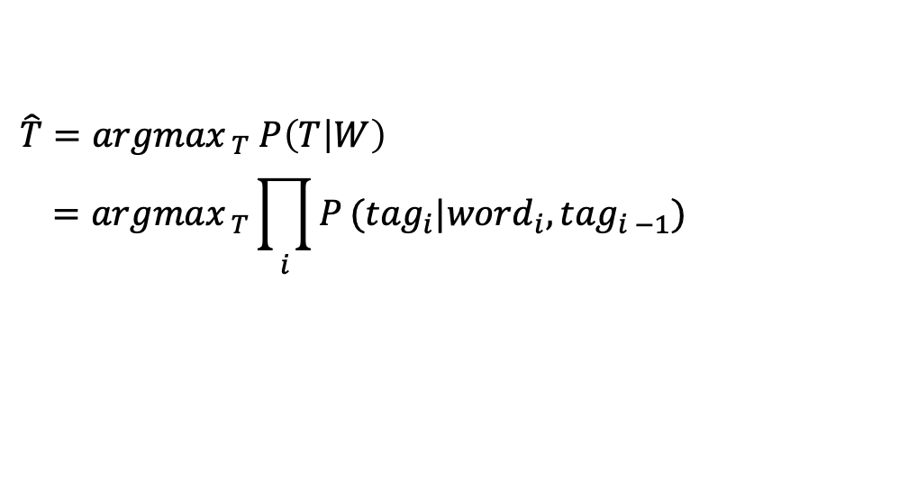
MEMMs v HMMs
HMM:
$$\hat{T}={argmax}_{ T} P\left(T | W\right)$$
$$={argmax}_{ T} P\left(W | T\right)P\left(T\right)$$
$$={argmax}_{ T}\prod_{i}{P}({word}_{i}|{tag}_{i})\prod_{i}{P}({tag}_{i}|{tag}_{i −1})$$
MEMM:
$$\hat{T}={argmax}_{ T} P\left(T | W\right)$$
$$={argmax}_{ T}\prod_{i}{P}({tag}_{i}|{{word}_{i}, tag}_{i −1})$$
Notes:
In an HMM to compute the best tag sequence that maximizes P(T |W ) we rely on Bayes’ rule and the likelihood P(W |T ).
In an MEMM, by contrast, we compute the posterior P(T |W ) directly, training it to discriminate among the possible tag sequences.

Slide 57
MEMMs v HMMs
HMM:
MEMM:
Notes:
In an HMM to compute the best tag sequence that maximizes P(T |W ) we rely on Bayes’ rule and the likelihood P(W |T ).
In an MEMM, by contrast, we compute the posterior P(T |W ) directly, training it to discriminate among the possible tag sequences.
A schematic view of the HMM (top) and MEMM (bottom) representation of the probability computation for the correct sequence of tags for the back sentence. The HMM computes the likelihood of the observation given the hidden state, while the MEMM computes the posterior of each state, conditioned on the previous state and current observation.

Slide 58
Features in a MEMM
We can build MEMMs that don’t just condition on w_{i} and t_{i-1}. It is easy to incorporate lots of features in a discriminative sequence model.
Notes:
A basic MEMM part-of-speech tagger conditions on the observation word it- self, neighboring words, and previous tags, and various combinations, using feature templates

Slide 59
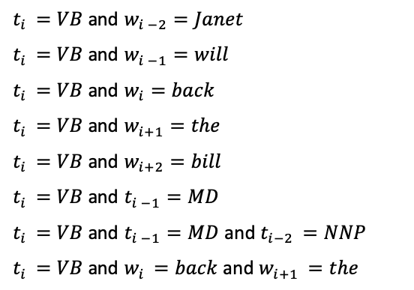
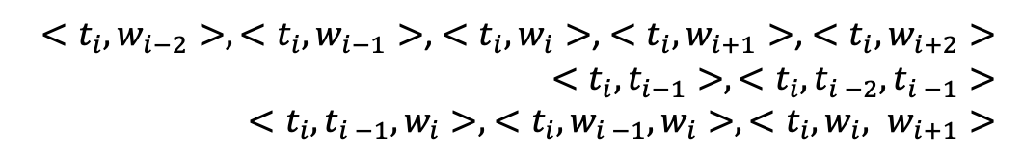
Feature templates
A basic MEMM part-of-speech tagger conditions on the observation word it- self, neighboring words, and previous tags, and various combinations, using feature templates like the following
Janet/NNP will/MD back/VB the/DT bill/NN, when w_{i} is the word back
$<t_{i}, w_{i−2}>,<t_{i}, w_{i−1}>$, $<t_{i}, w_{i}>$, $<t_{i}, w_{i+1}>$, $<t_{i}, w_{i+2}>$
$<t_{i}, t_{i−1}>,<t_{i},t_{i −2},t_{i −1}>$
$<t_{i},t_{i −1}, w_{i}>,$ $<t_{i}, {w_{i −1}, w}_{i}>, <t_{i}, {w_{i}, w}_{i+1}>$
$t_{i }=VB$ and $w_{i −2}=Janet$
$t_{i }=VB$ and $w_{i −1}=will$
$t_{i }=VB$ and $w_{i}=back$
$t_{i }=VB$ and $w_{i+1}=the$
$t_{i }=VB$ and $w_{i+2}=bill$
$t_{i }=VB$ and $t_{i −1}=MD$
$t_{i }=VB$ and $t_{i −1}=MD$ and $t_{i−2 }=NNP$
$t_{i }=VB$ and $w_{i }=back$ and $w_{i+1 }=the$

Slide 60
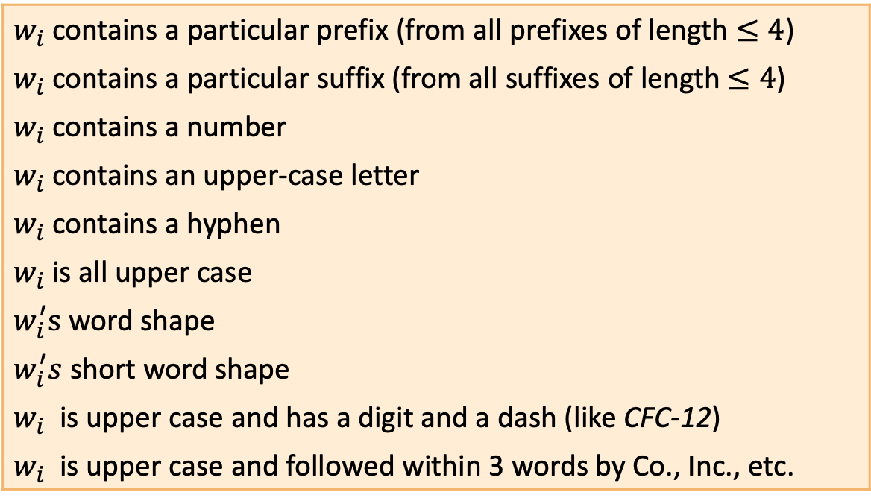
Features for unknown words
$w_{i}$ contains a particular prefix (from all prefixes of length $≤4$)
$w_{i}$ contains a particular suffix (from all suffixes of length $≤4$)
$w_{i}$ contains a number
$w_{i}$ contains an upper-case letter
$w_{i}$ contains a hyphen
$w_{i}$ is all upper case
$w_{i}^{′}s$ word shape
$w_{i}^{′}s$ short word shape
$w_{i}$ is upper case and has a digit and a dash (like CFC-12)
$w_{i}$ is upper case and followed within 3 words by Co., Inc., etc.

Slide 61
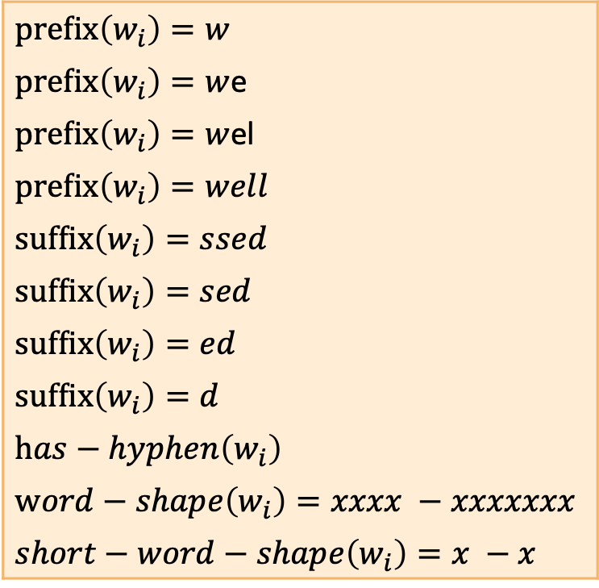
Features for well-dressed
$prefix\left(w_{i}\right)=w$
$prefix\left(w_{i}\right)=w$e
$prefix\left(w_{i}\right)=w$el
$prefix\left(w_{i}\right)=well$
$suffix\left(w_{i}\right)=ssed$
$suffix\left(w_{i}\right)=sed$
$suffix\left(w_{i}\right)=ed$
$suffix\left(w_{i}\right)=d$
$has−hyphen\left(w_{i}\right)$
$word−shape\left(w_{i}\right)=xxxx −xxxxxxx$
$short−word−shape\left(w_{i}\right)=x −x$

Slide 62
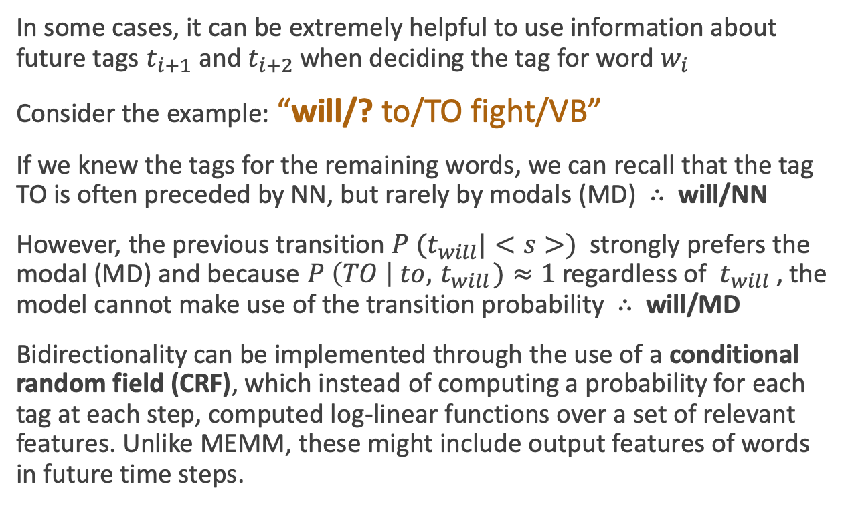
Bidirectionality
In some cases, it can be extremely helpful to use information about future tags $t_{i+1}$ and $t_{i+2}$ when deciding the tag for word $w_{i}$
Consider the example: “will/? to/TO fight/VB”
If we knew the tags for the remaining words, we can recall that the tag TO is often preceded by NN, but rarely by modals (MD) $∴$ will/NN
However, the previous transition ${P (t}_{will}|<s>)$ strongly prefers the modal (MD) and because $P \left(TO \right| to, { t}_{will})≈1$regardless of ${ t}_{will}$ , the model cannot make use of the transition probability $∴$ will/MD
Bidirectionality can be implemented through the use of a conditional random field (CRF), which instead of computing a probability for each tag at each step, computed log-linear functions over a set of relevant features. Unlike MEMM, these might include output features of words in future time steps.

Slide 63
Morphologically Rich Languages
Both morphologically rich and highly inflectional languages are challenging since they have a large vocabulary: a 250,000 word token corpus of Hungarian has more than twice as many word types as a similarly sized corpus of English.
For these languages, POS taggers need to label words with case and gender information as well, resulting in novel tagsets in the form of sequences of morphological tags rather than a single tag.
Ex. Üzerinde parmak izin kalmiş (iz + Noun + A3sg + P2sg + Nom)

